Slide 1
Project 1 nyc_airbnb_data
Carlos Gallegos

Slide 2
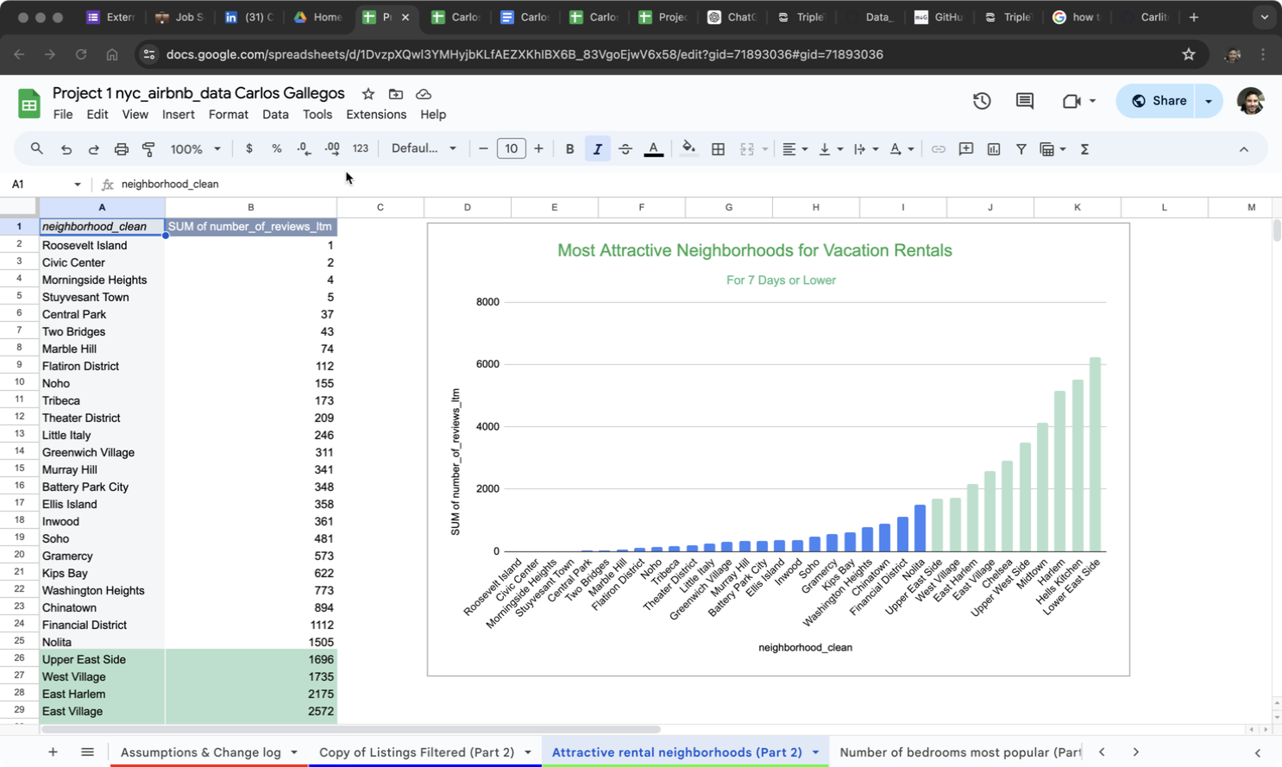
Attractive rental neighborhoods

Slide 3
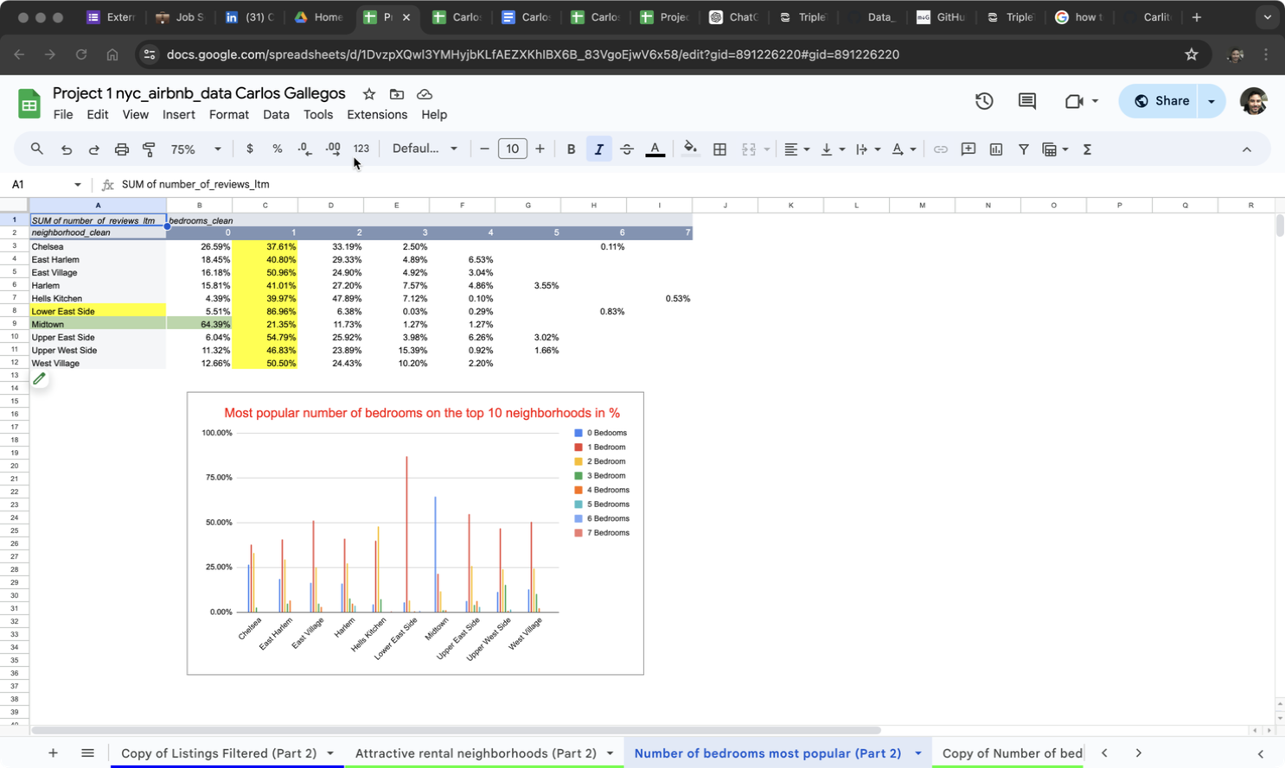
Number of bedrooms most popular

Slide 4
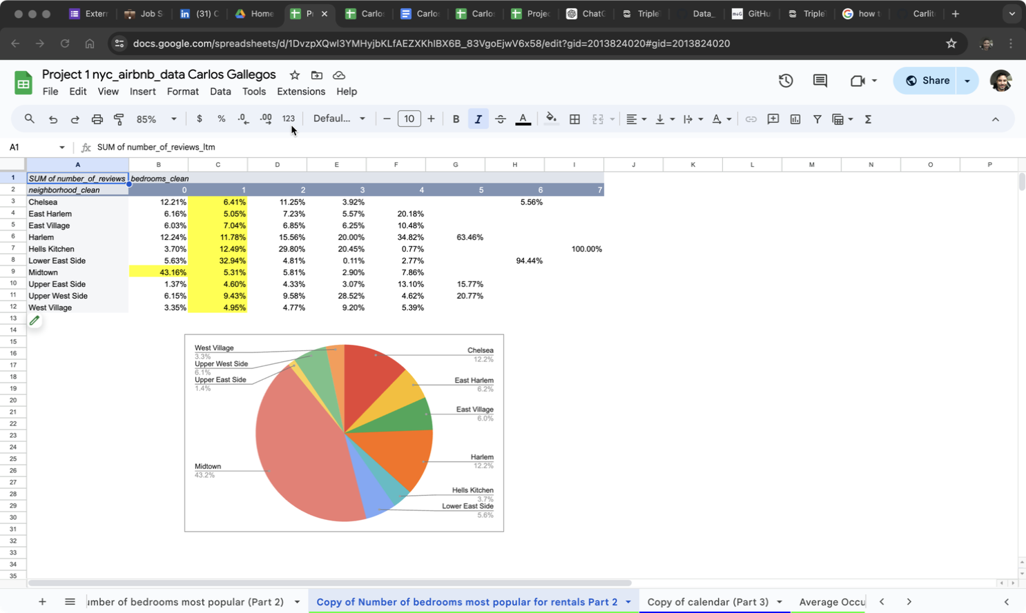
Copy of Number of bedrooms most popular for rentals

Slide 5
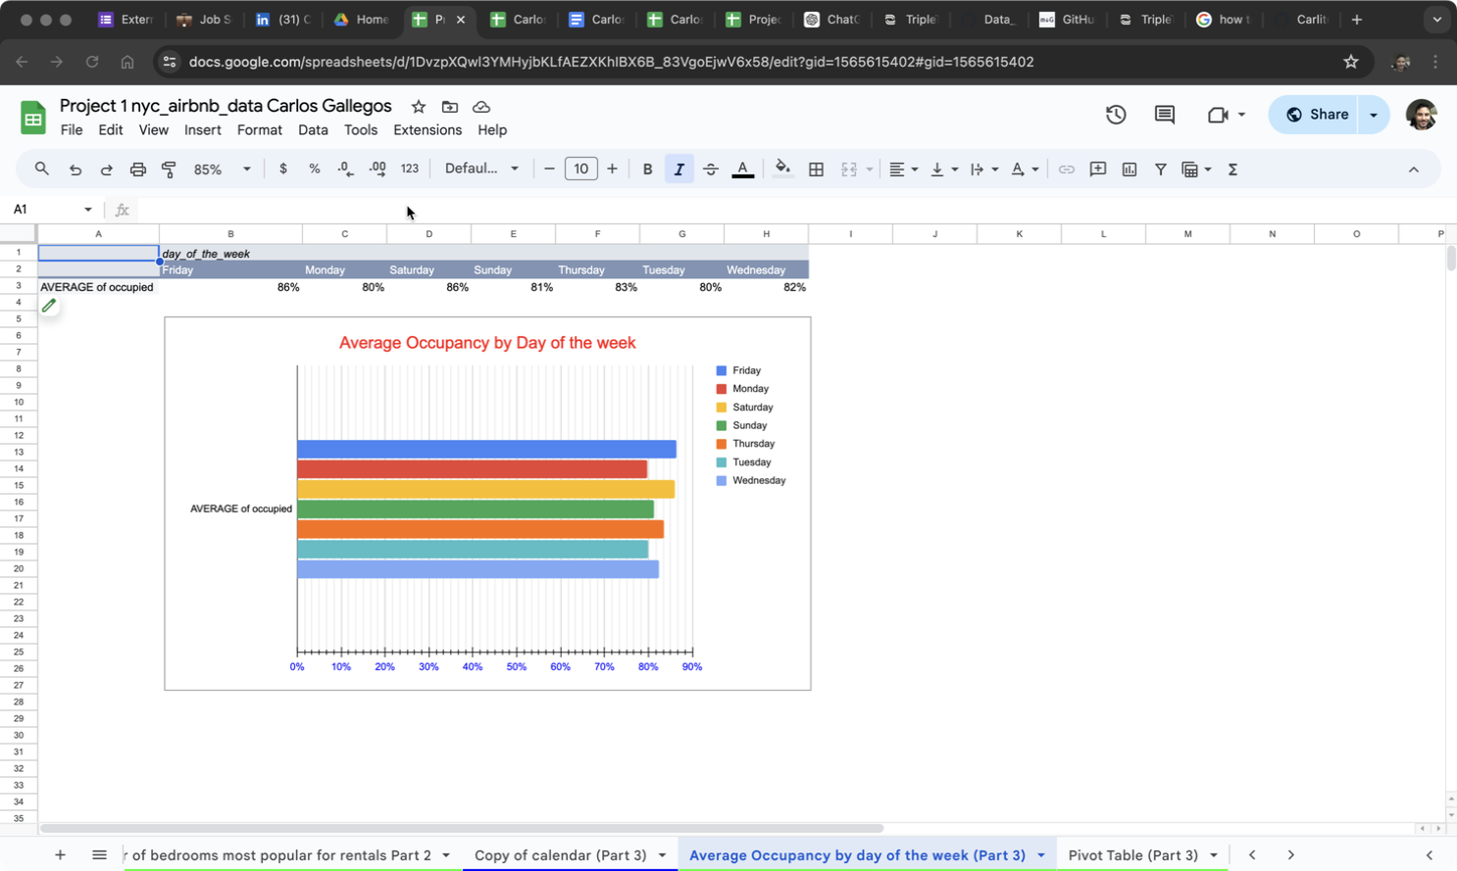
Average Occupancy by day of the week

Slide 6
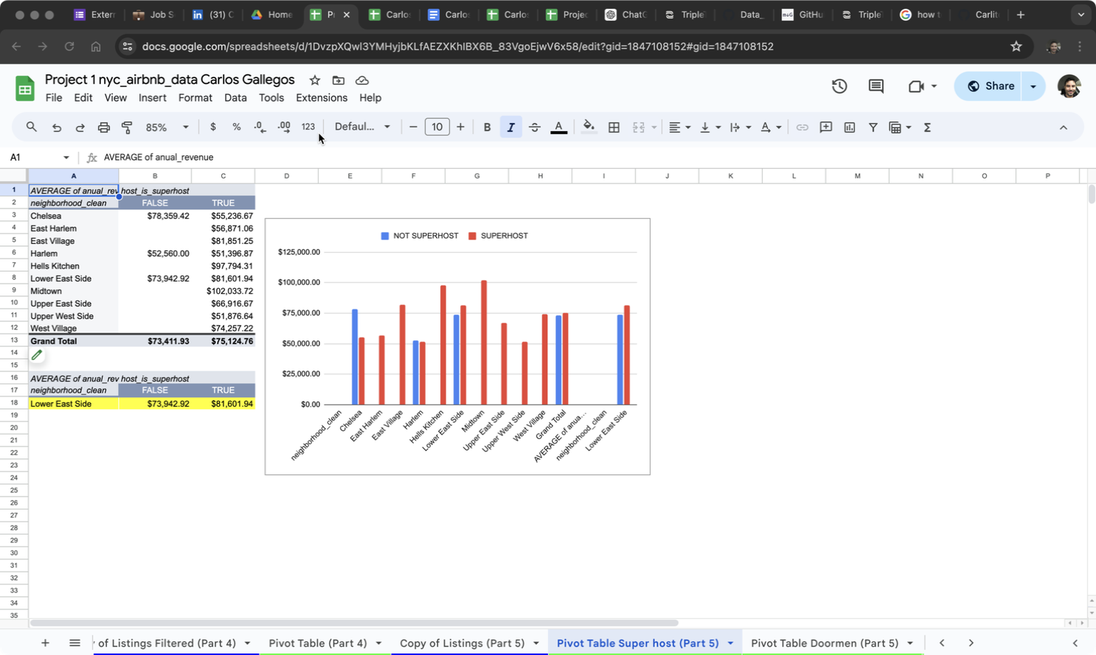
Pivot Table Super host

Slide 7
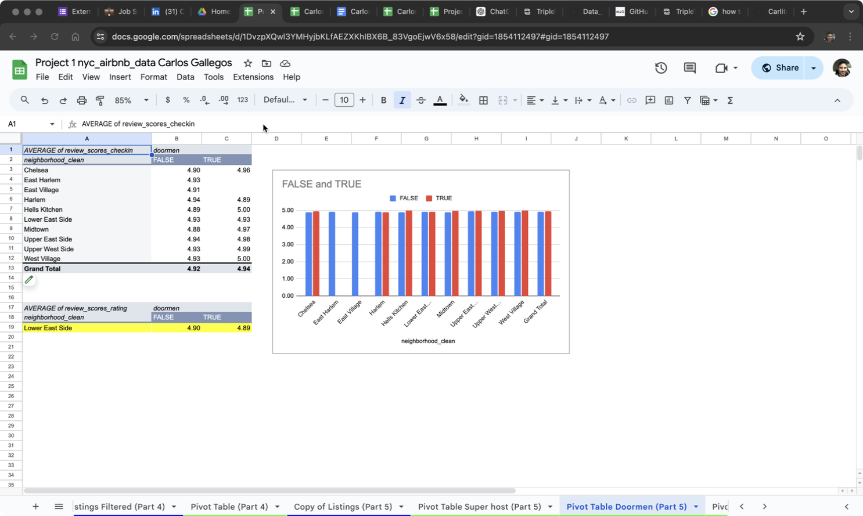
Pivot Table Doormen

Slide 8
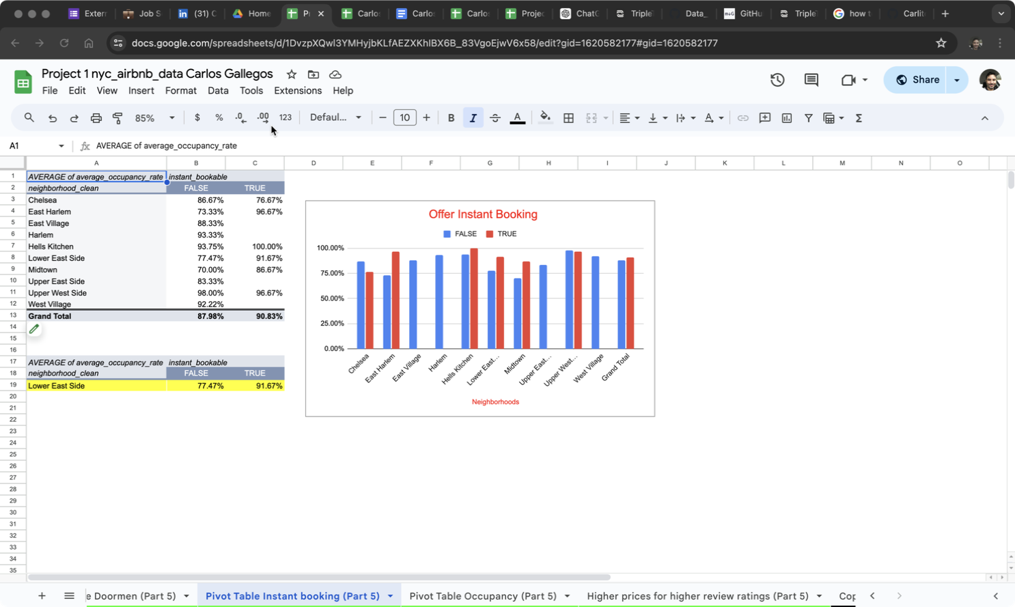
Pivot Table Instant booking

Slide 9
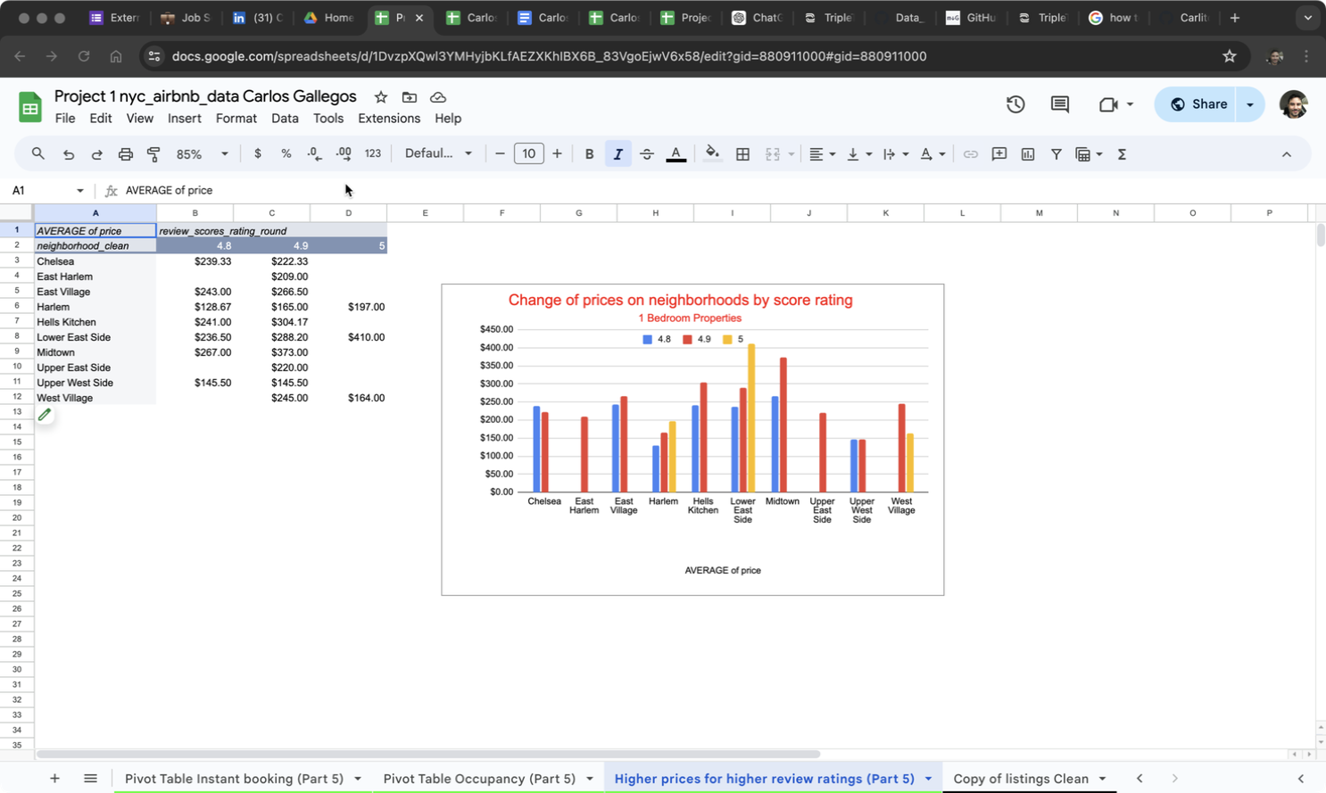
Higher prices for higher review ratings

Slide 10
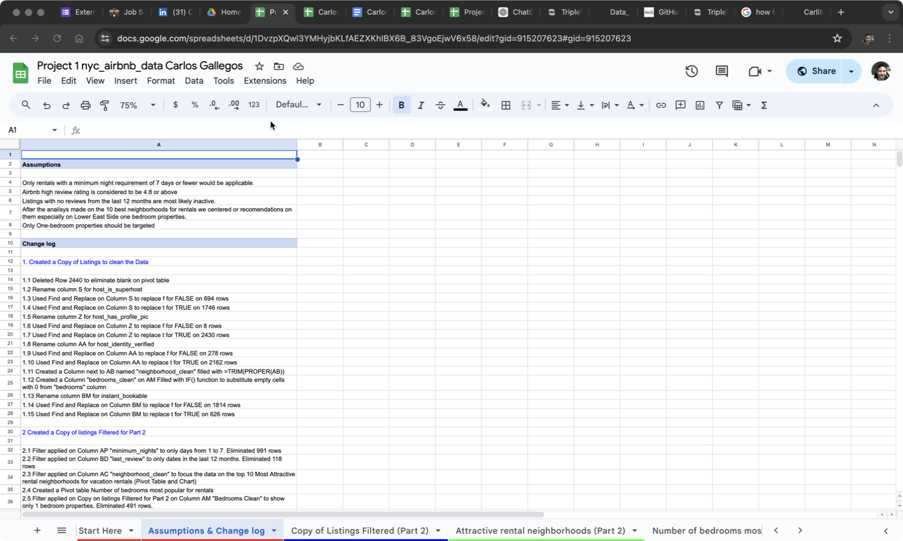
Assumptions & Change log

Slide 11
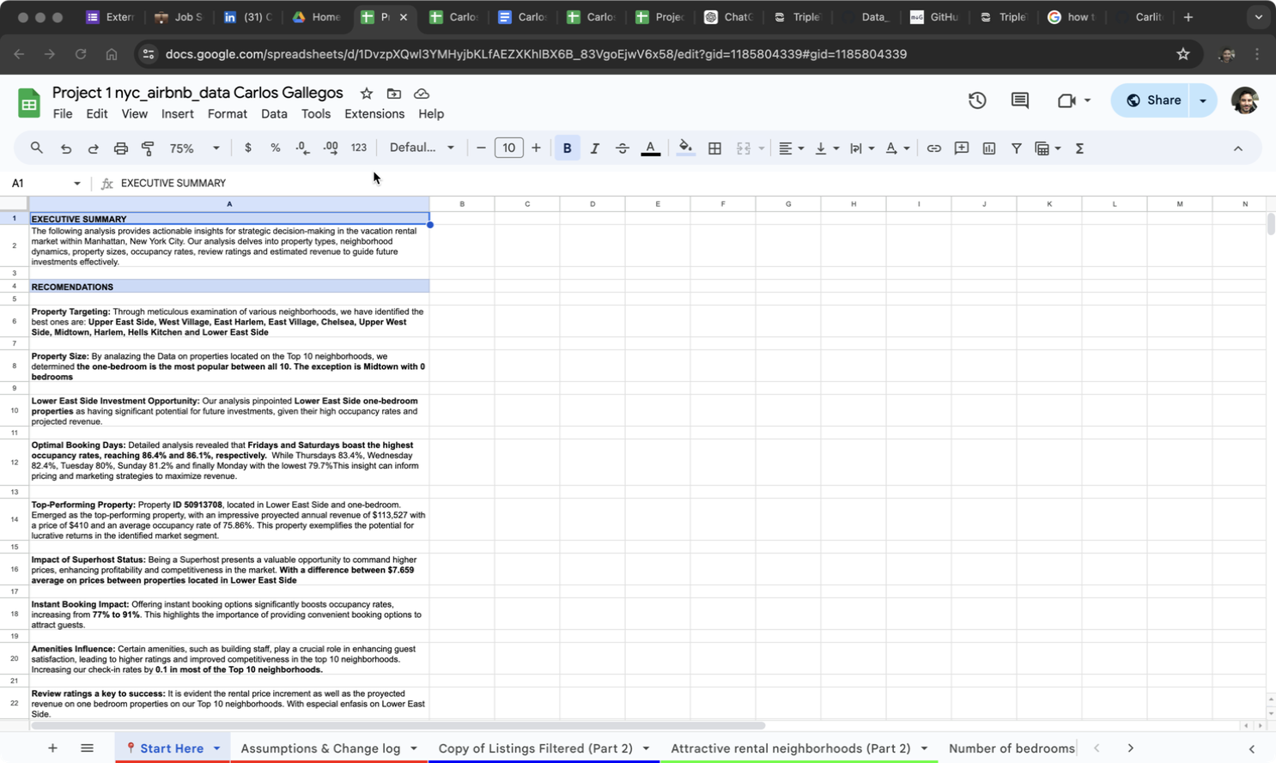
Executive Summary & Recomendations

Slide 12
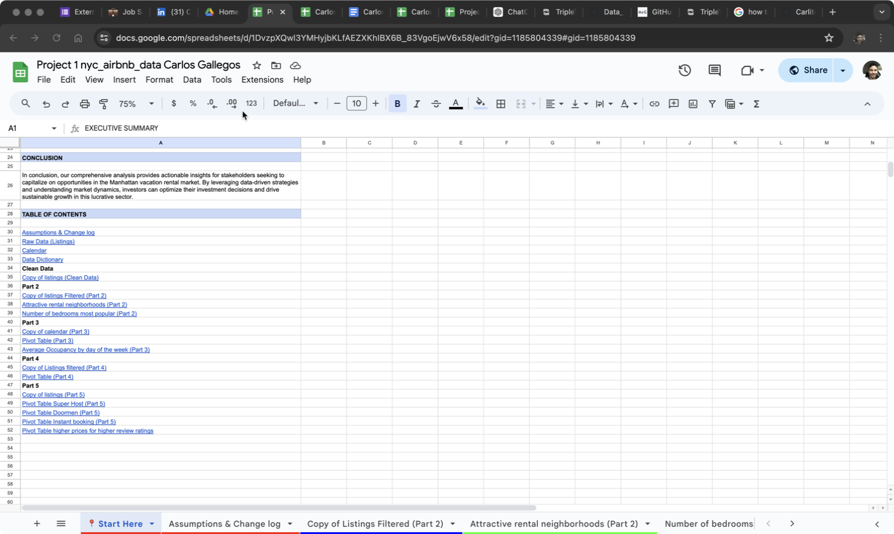
Conclusion & Table of Contents

